Slide 1
Quantitative Risk Management Lecture 5: Expected Shortfall, Coherence and Aggregate Risk
Roy E. DeMeo, Jr.

Slide 2
Main Topics
Purpose is to relate risk for a portfolio to the risks of each of its components.
We revisit Expected Shortfall, an alternative to VaR, which is a coherent risk measure and reflects tail risk better than VaR.
We explore other ways of computing risk for a portfolio, and also consider distributions for which VaR is also coherent.

Slide 3
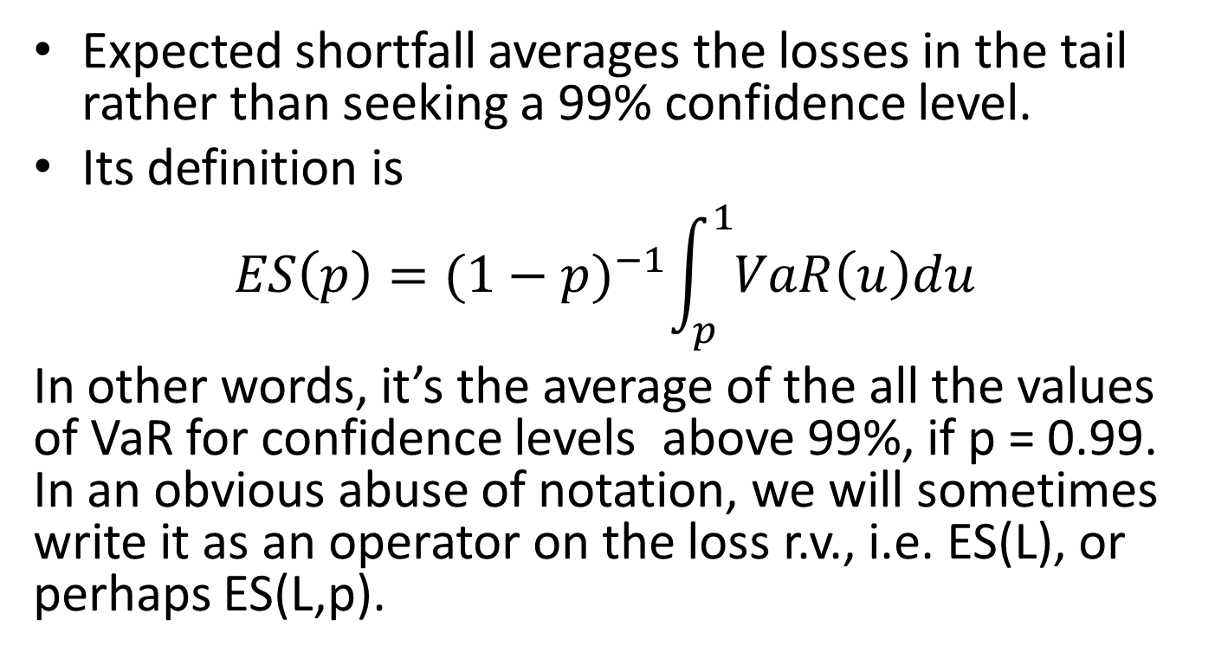
Expected Shortfall
Expected shortfall averages the losses in the tail rather than seeking a 99% confidence level.
Its definition is
$$ES\left(p\right)={(1−p)}^{−1}\int_{p}^{1}{VaR\left(u\right)du}$$
In other words, it’s the average of the all the values of VaR for confidence levels above 99%, if p = 0.99. In an obvious abuse of notation, we will sometimes write it as an operator on the loss r.v., i.e. ES(L), or perhaps ES(L,p).

Slide 4

Expected Shortfall, Continued
Another way to write it is
$$ES\left(L,p\right)=E(L|L≥VaR\left(p\right))$$
We will prove that these two formulations are equivalent.

Slide 5
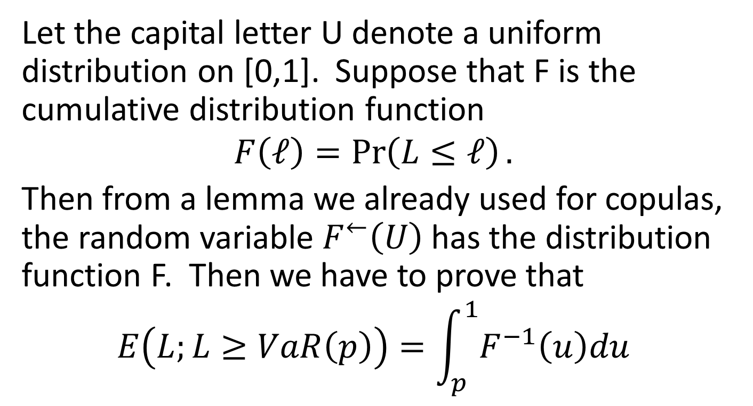
Proof of Equivalence of ES Calculations
Let the capital letter U denote a uniform distribution on [0,1]. Suppose that F is the cumulative distribution function
$$F\left(ℓ\right)=\operatorname{Pr}\left(L≤ℓ\right).$$
Then from a lemma we already used for copulas, the random variable $F^{←}\left(U\right)$ has the distribution function F. Then we have to prove that
$$E\left(L;L≥VaR\left(p\right)\right)=\int_{p}^{1}{F^{−1}\left(u\right)du}$$

Slide 6
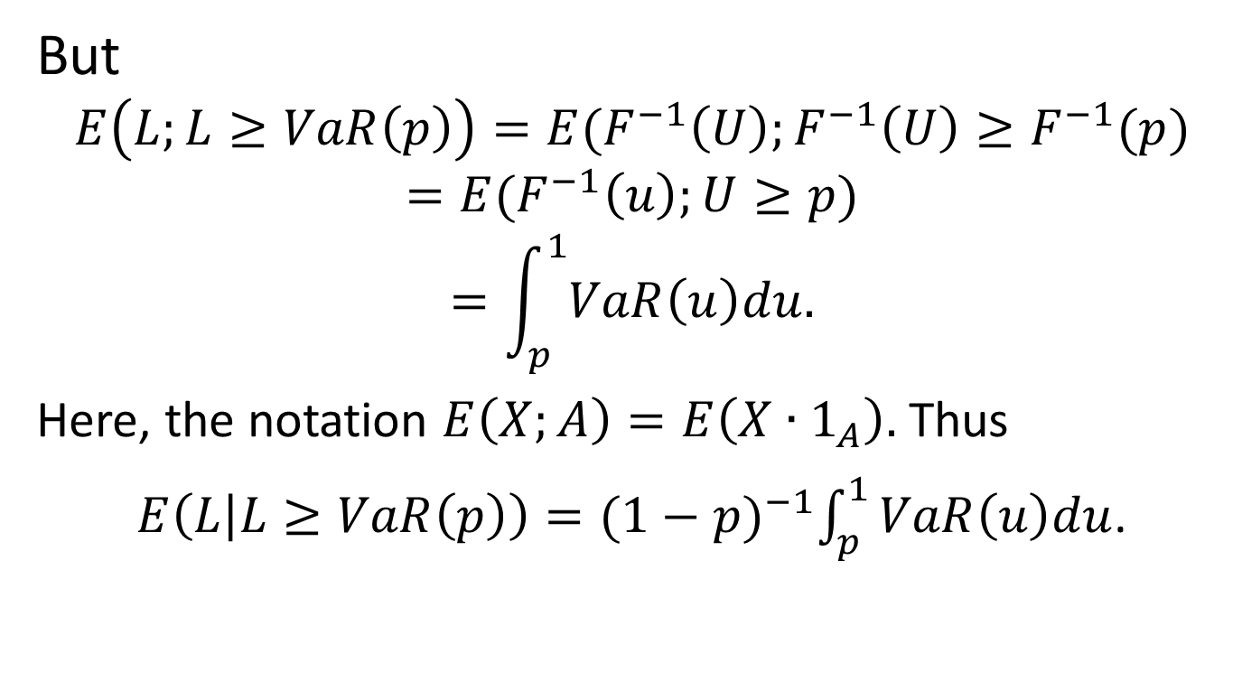
Equivalence Proof, Cont’d
But
$$E\left(L;L≥VaR\left(p\right)\right)=E(F^{−1}\left(U\right);F^{−1}\left(U\right)≥F^{−1}(p)$$
$$=E(F^{−1}\left(u\right);U≥p)$$
$$=\int_{p}^{1}{VaR\left(u\right)du.}$$
Here, the notation $E\left(X;A\right)=E\left(X∙1_{A}\right).$ Thus
$E\left(L | L≥VaR\left(p\right)\right)={(1−p)}^{−1}\int_{p}^{1}{VaR\left(u\right)du}$.

Slide 7
ES Properties
Many banks are computing expected shortfall in addition to VaR. Regulators are moving towards asking for it.
ES at 2.5% is usually close to VaR at 1 %.
ES is better than VaR at accounting for risk of extreme losses (tail risk).
ES can be computed with either MC or historical simulation

Slide 8
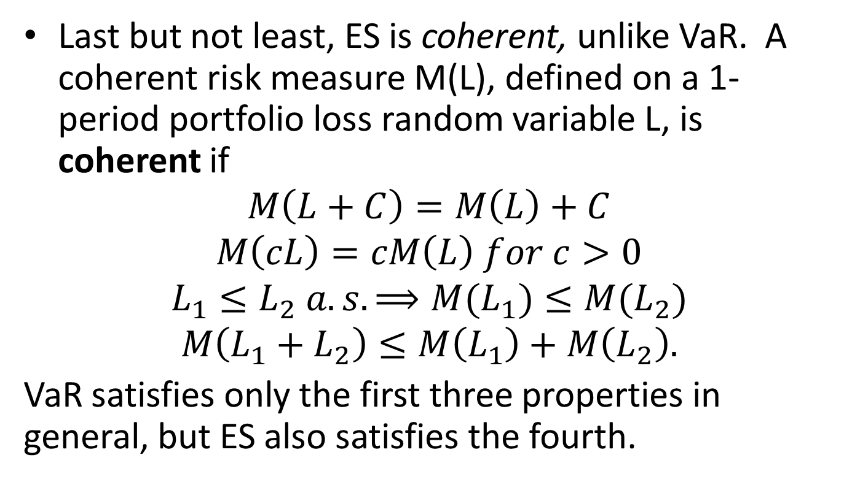
ES Coherence
Last but not least, ES is coherent, unlike VaR. A coherent risk measure M(L), defined on a 1-period portfolio loss random variable L, is coherent if
$$M\left(L+C\right)=M\left(L\right)+C$$
$$M\left(cL\right)=cM\left(L\right) for c>0$$
$$L_{1}≤L_{2} a.s. ⟹M(L_{1})≤M(L_{2})$$
$$M\left(L_{1}+L_{2}\right)≤M\left(L_{1}\right)+M\left(L_{2}\right).$$
VaR satisfies only the first three properties in general, but ES also satisfies the fourth.

Slide 9
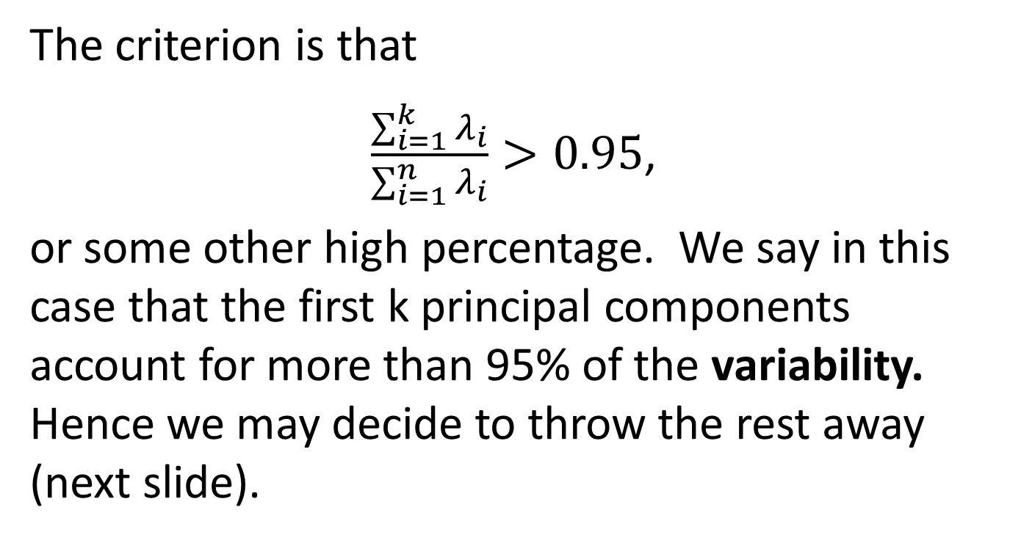
Example: VaR is Not Coherent
Suppose the two worst losses of portfolio $P_{1}$ in the last year occurred on April 5 and June 3, and they were $100 and $120, respectively.
Suppose that $P_{2}$ had its two worst losses in the past year on the same dates, but they were $150 and $120, respectively.
The two worst losses for $P_{1}+P_{2}$ are therefore $250 and $240, so VaR is $240. But for $P_{1}$, VaR is $100, and for $P_{2},$ VaR is $120.
Since $100 + $120 < $240, that violates subadditivity, and hence coherence.

Slide 10
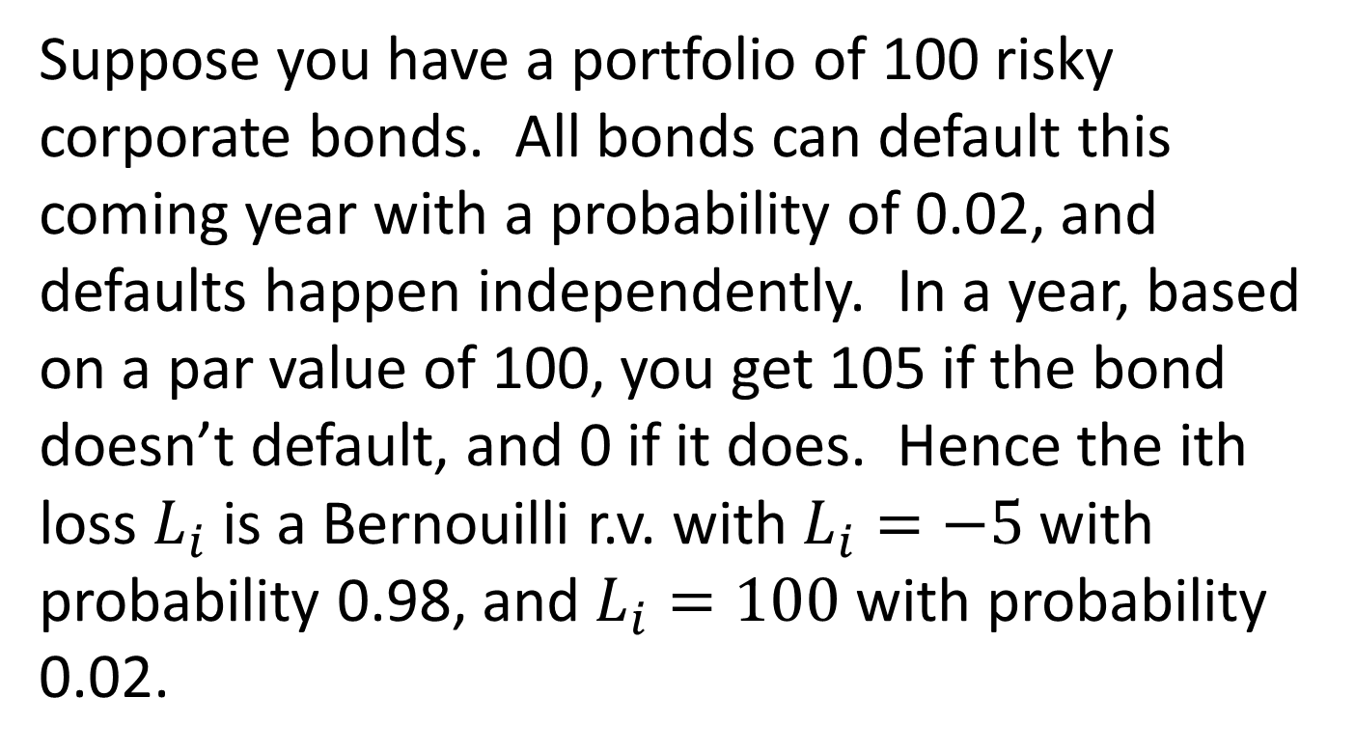
Another Example of VaR Incoherence
Suppose you have a portfolio of 100 risky corporate bonds. All bonds can default this coming year with a probability of 0.02, and defaults happen independently. In a year, based on a par value of 100, you get 105 if the bond doesn’t default, and 0 if it does. Hence the ith loss $L_{i}$ is a Bernouilli r.v. with $L_{i}=−5$with probability 0.98, and $L_{i}=100$ with probability 0.02.

Slide 11
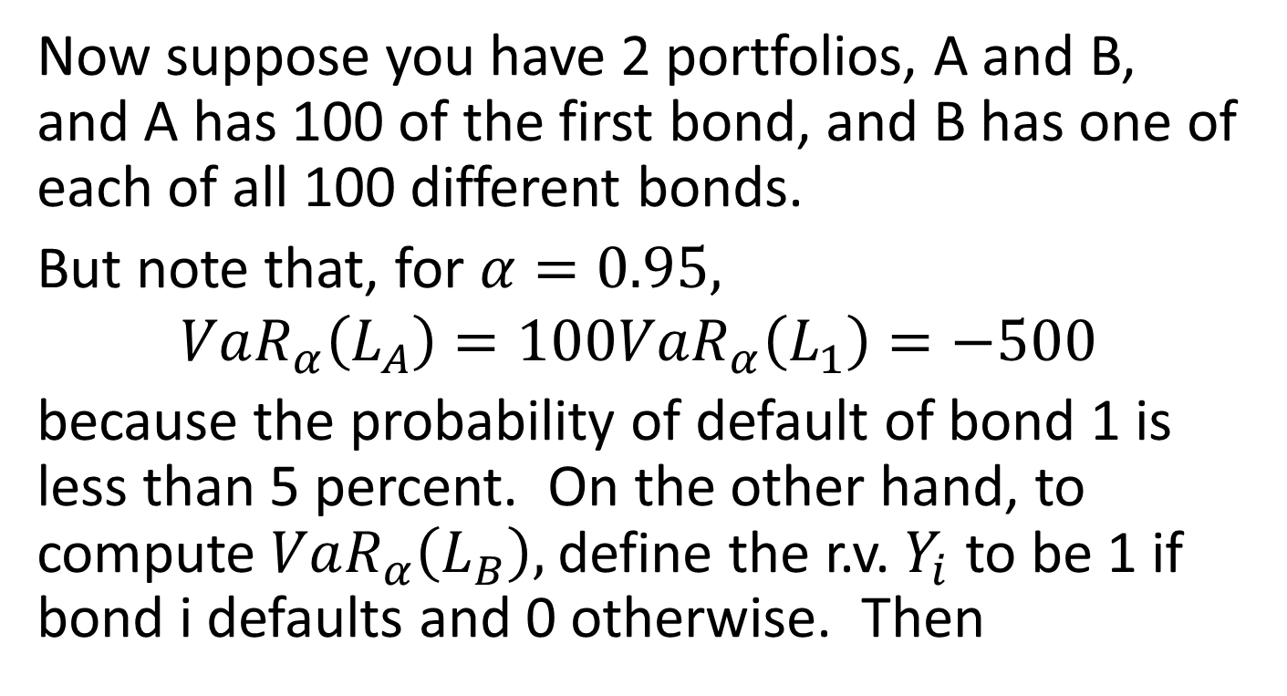
VaR Incoherence, cont’d
Now suppose you have 2 portfolios, A and B, and A has 100 of the first bond, and B has one of each of all 100 different bonds.
But note that, for $α=0.95,$
$$VaR_{α}\left(L_{A}\right)=100VaR_{α}\left(L_{1}\right)=−500$$
because the probability of default of bond 1 is less than 5 percent. On the other hand, to compute $VaR_{α}\left(L_{B}\right),$ define the r.v. $Y_{i}$ to be 1 if bond i defaults and 0 otherwise. Then

Slide 12
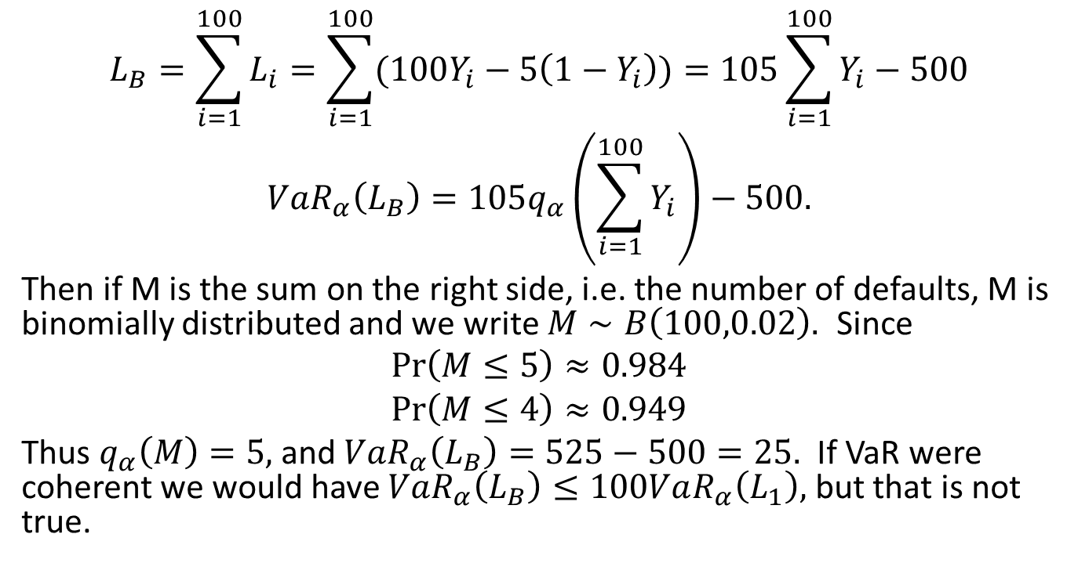
VaR Incoherence, cont’d
$$L_{B}=\sum_{i=1}^{100}{L_{i}}=\sum_{i=1}^{100}{(100Y_{i}−5\left(1−Y_{i}\right))}=105\sum_{i=1}^{100}{Y_{i}}−500$$
$$VaR_{α}\left(L_{B}\right)=105q_{α}\left(\sum_{i=1}^{100}{Y_{i}}\right)−500.$$
Then if M is the sum on the right side, i.e. the number of defaults, M is binomially distributed and we write $M∼B\left(100,0.02\right).$ Since
$$\operatorname{Pr}\left(M≤5\right)≈0.984$$
$\operatorname{Pr}\left(M≤4\right)≈0.949$
Thus $q_{α}\left(M\right)=5,$ and $VaR_{α}\left(L_{B}\right)=525−500=25.$ If VaR were coherent we would have $VaR_{α}\left(L_{B}\right)≤100VaR_{α}\left(L_{1}\right),$ but that is not true.

Slide 13
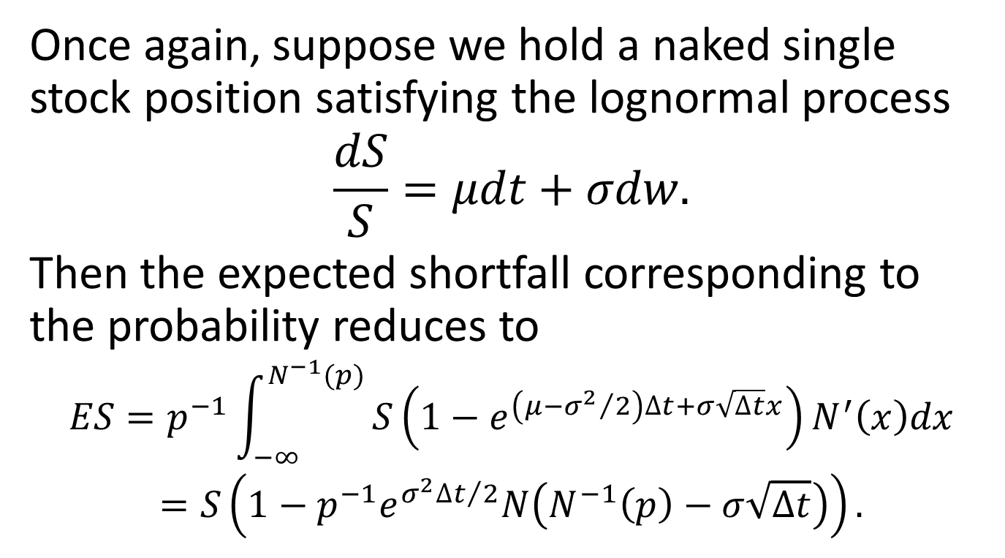
ES Simple Example
Once again, suppose we hold a naked single stock position satisfying the lognormal process
$$\frac{dS}{S}=μdt+σdw.$$
Then the expected shortfall corresponding to the probability reduces to
$$ES=p^{−1}\int_{−∞}^{N^{−1}(p)}{S\left(1−e^{\left(μ−{σ^{2}}/2\right)∆t+σ\sqrt{∆t}x}\right)N^{′}\left(x\right)dx}$$
$$=S\left(1−p^{−1}e^{{σ^{2}∆t}/2}N\left(N^{−1}\left(p\right)−σ\sqrt{∆t}\right)\right).$$

Slide 14
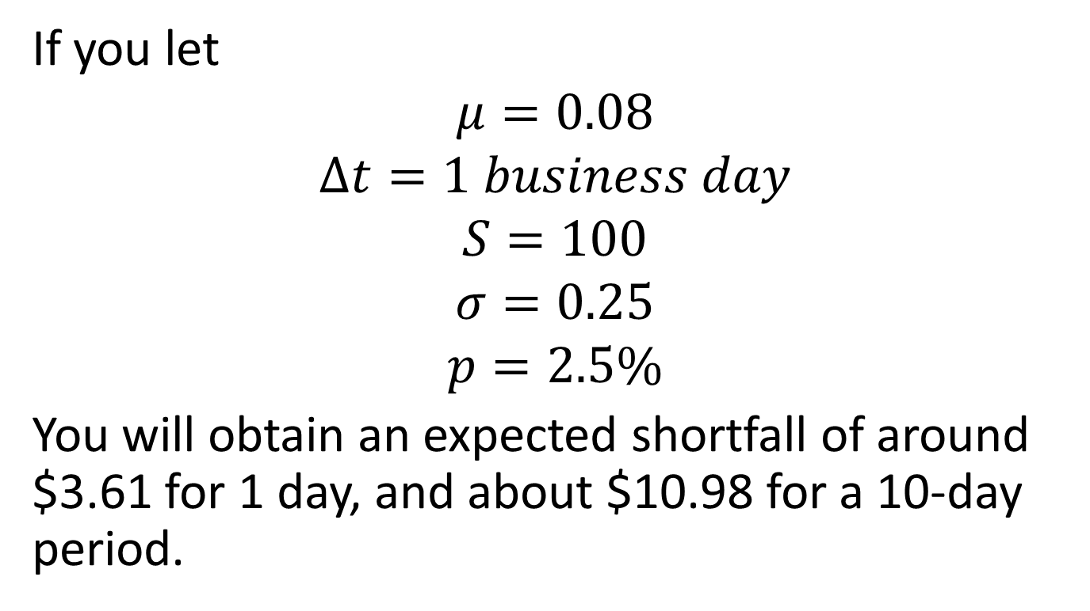
ES Simple Example, Cont’d
If you let
$$μ=0.08$$
$$∆t=1 business day$$
$$S=100$$
$$σ=0.25$$
$$p=2.5\%$$
You will obtain an expected shortfall of around $3.61 for 1 day, and about $10.98 for a 10-day period.

Slide 15
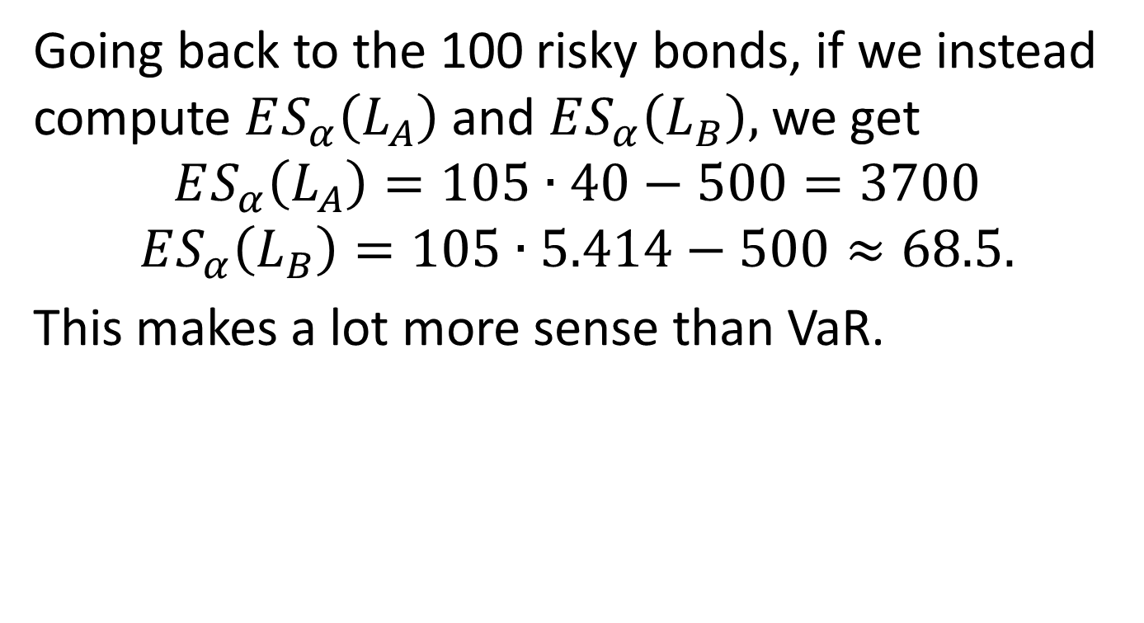
ES for the Bond Example
Going back to the 100 risky bonds, if we instead compute $ES_{α}\left(L_{A}\right)$ and $ES_{α}\left(L_{B}\right),$ we get
$$ES_{α}\left(L_{A}\right)=105∙40−500=3700$$
$$ES_{α}\left(L_{B}\right)=105∙5.414−500≈68.5.$$
This makes a lot more sense than VaR.

Slide 16
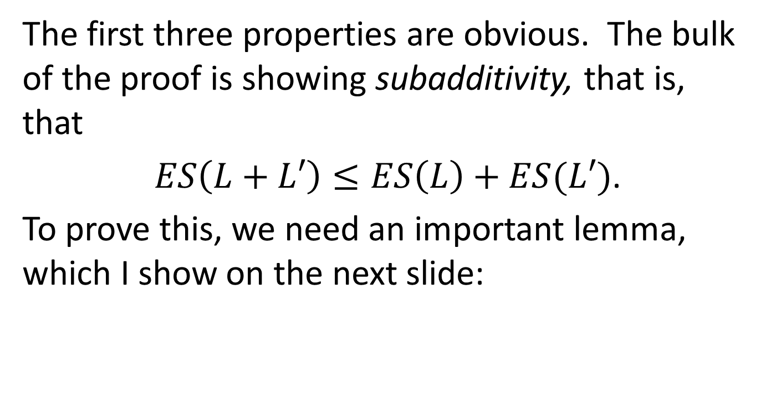
Proof that ES is Coherent
The first three properties are obvious. The bulk of the proof is showing subadditivity, that is, that
$ES\left(L+L′\right)≤ES\left(L\right)+ES(L′)$.
To prove this, we need an important lemma, which I show on the next slide:

Slide 17
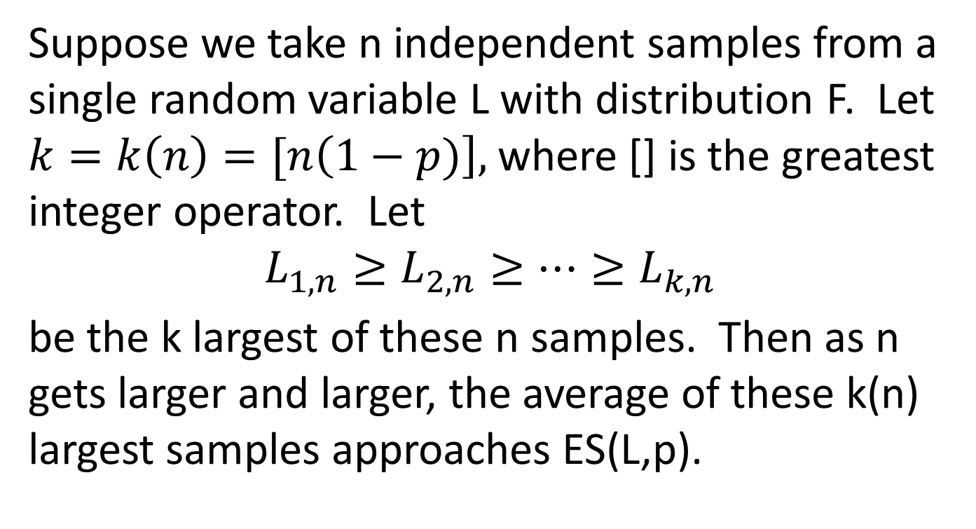
Law of Large Numbers for Tails
Suppose we take n independent samples from a single random variable L with distribution F. Let $k=k\left(n\right)=[n\left(1−p)\right],$ where [] is the greatest integer operator. Let
$$L_{1,n}≥L_{2,n}≥…≥L_{k,n}$$
be the k largest of these n samples. Then as n gets larger and larger, the average of these k(n) largest samples approaches ES(L,p).

Slide 18
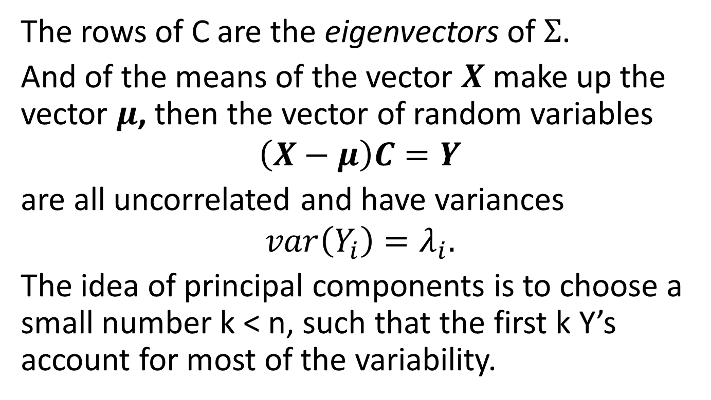
ES is Coherent, Cont’d
Note that if we take n independent samples of the loss random variable L, denoted
$$L_{1},…,L_{n},$$
then the sum of the largest k is just the maximum of the sum of any subset of k out of n, namely
$$\sum_{i=1}^{k}{L_{i,n}=\max_{{1≤i}_{1}<…<i_{k}≤n}{\sum_{j=1}^{k}{L_{i_{j}}}}.}$$

Slide 19
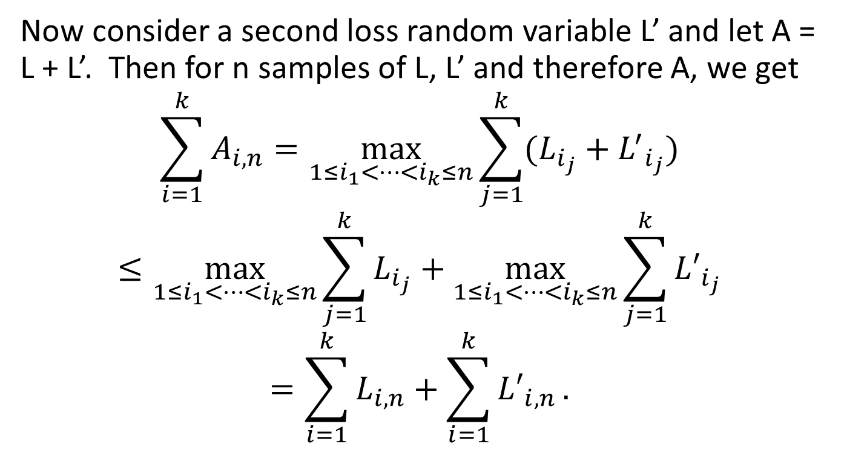
ES is Coherent, Cont’d
Now consider a second loss random variable L’ and let A = L + L’. Then for n samples of L, L’ and therefore A, we get
$$\sum_{i=1}^{k}{A_{i,n}=\max_{1≤i_{1}<…<i_{k}≤n}{\sum_{j=1}^{k}{(L_{i_{j}}+{L^{′}}_{i_{j}})}}}$$
$$≤\max_{1≤i_{1}<…<i_{k}≤n}{\sum_{j=1}^{k}{L_{i_{j}}}}+\max_{1≤i_{1}<…<i_{k}≤n}{\sum_{j=1}^{k}{{L′}_{i_{j}}}}$$
$$=\sum_{i=1}^{k}{L_{i,n}}+\sum_{i=1}^{k}{{L′}_{i,n}}.$$

Slide 20
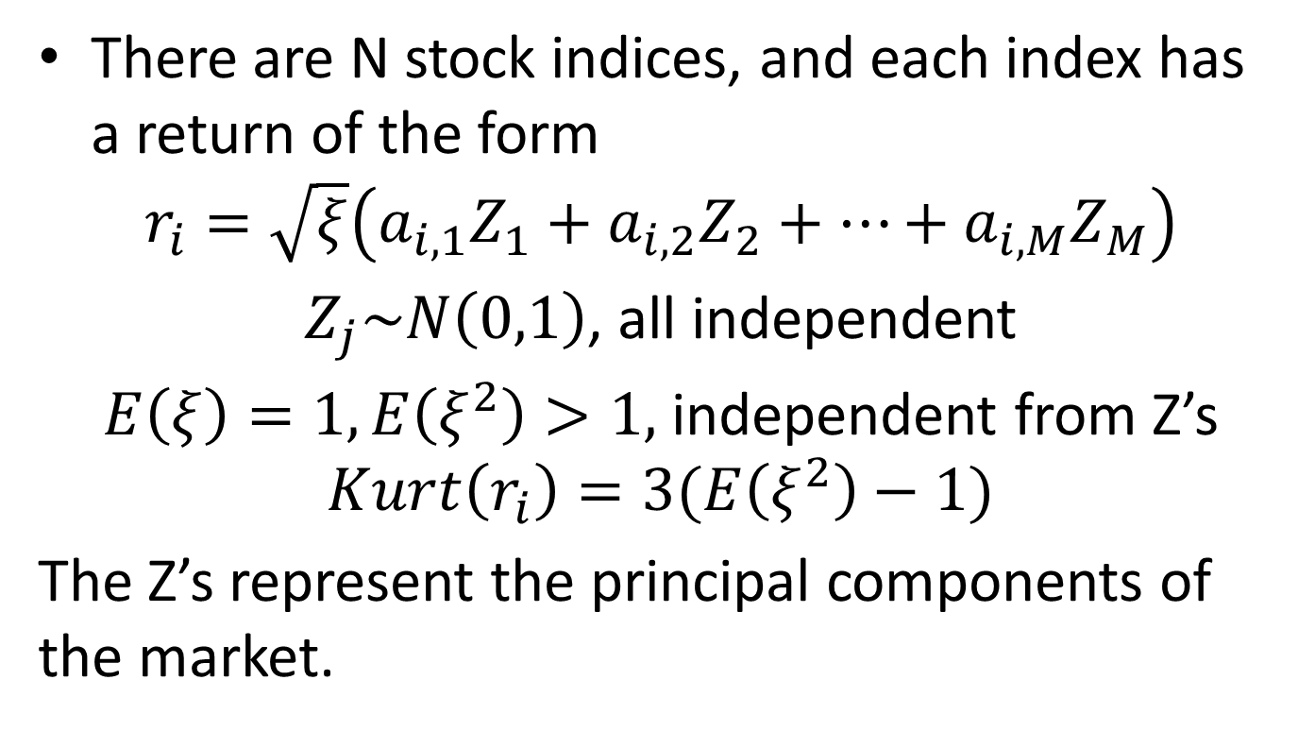
ES is Coherent, Conclusion
Then clearly,
$$\frac{1}{k}\sum_{i=1}^{k}{A_{i,n}}≤\frac{1}{k}\sum_{i=1}^{k}{L_{i,n}}+\frac{1}{k}\sum_{i=1}^{k}{{L^{′}}_{i,n}}.$$
Finally, we let $k=k\left(n\right)=\left[n\left(1−p\right)\right],$ and take the limit as $n→∞,$ and we get, from the law of large numbers for tails,
$$ES\left(A,p\right)≤ES\left(L,p\right)+ES\left(L^{′},p\right).$$

Slide 21
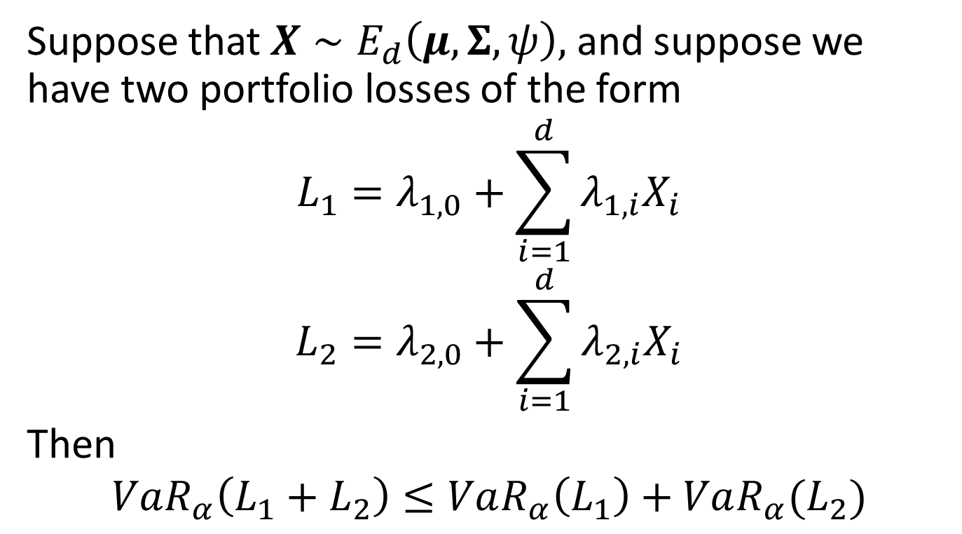
But VaR is coherent, too, if the risk factors are elliptical
Suppose that $X∼E_{d}\left(μ,Σ,ψ\right),$ and suppose we have two portfolio losses of the form
$$L_{1}=λ_{1,0}+\sum_{i=1}^{d}{λ_{1,i}X_{i}}$$
$$L_{2}=λ_{2,0}+\sum_{i=1}^{d}{λ_{2,i}X_{i}}$$
Then
$$VaR_{α}\left(L_{1}+L_{2}\right)≤VaR_{α}\left(L_{1}\right)+VaR_{α}(L_{2})$$

Slide 22
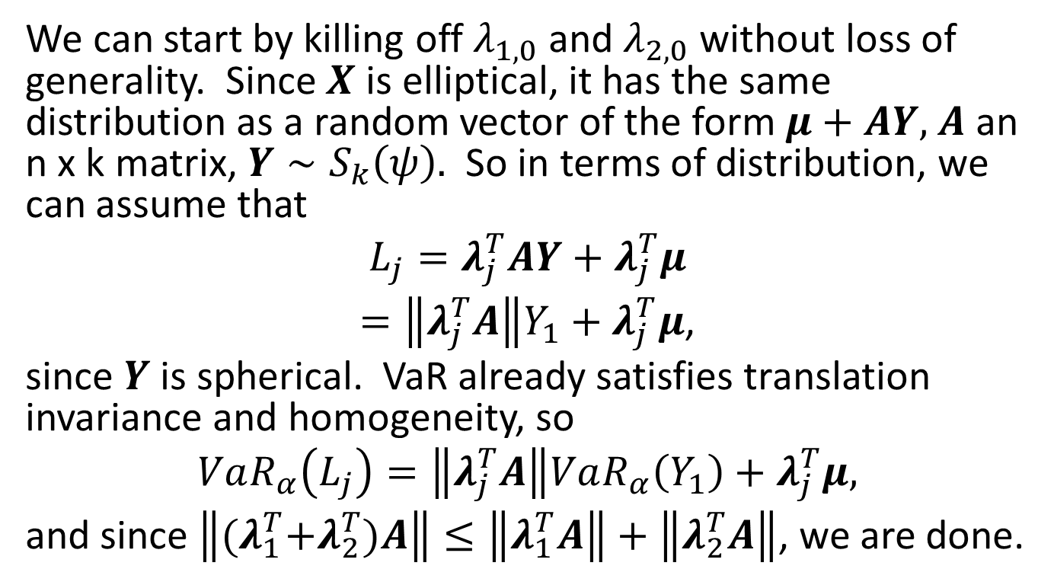
Coherent VaR for Elliptical Risk Factors, cont’d
We can start by killing off $λ_{1,0}$ and $λ_{2,0}$ without loss of generality. Since $X$ is elliptical, it has the same distribution as a random vector of the form $μ+AY,$ $A$ an n x k matrix, $Y∼S_{k}\left(ψ\right).$ So in terms of distribution, we can assume that
$$L_{j}=λ_{j}^{T}AY+λ_{j}^{T}μ$$
$=\left\|λ_{j}^{T}A\right\|Y_{1}+λ_{j}^{T}μ$,
since $Y$ is spherical. VaR already satisfies translation invariance and homogeneity, so
$$VaR_{α}\left(L_{j}\right)=\left\|λ_{j}^{T}A\right\|VaR_{α}\left(Y_{1}\right)+λ_{j}^{T}μ,$$
and since $\left\|{(λ}_{1}^{T}+λ_{2}^{T})A\right\|≤\left\|λ_{1}^{T}A\right\|+\left\|λ_{2}^{T}A\right\|$, we are done.

Slide 23
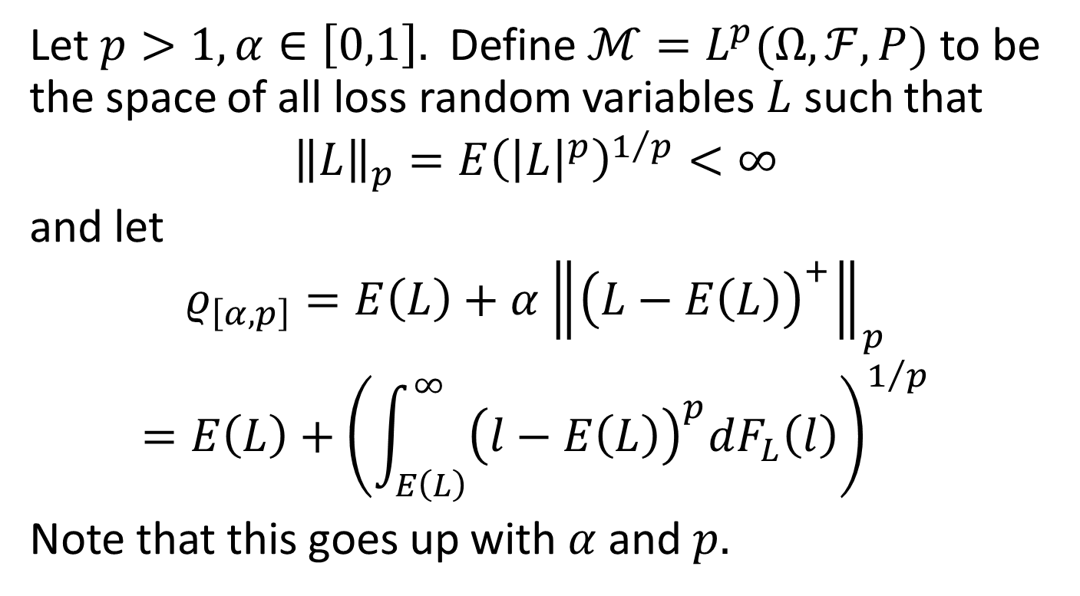
Another Coherent Risk Measure
Let $p>1, α∈\left[0,1\right].$ Define $ℳ=L^{p}(Ω,ℱ,P)$ to be the space of all loss random variables $L$ such that
$${\left\|L\right\|}_{p}=E{\left({\left|L\right|}^{p}\right)}^{1/p}<∞$$
and let
$$ρ_{\left[α,p\right]}=E\left(L\right)+α{\left\|{\left(L−E\left(L\right)\right)}^{+}\right\|}_{p}$$
$$=E\left(L\right)+{\left(\int_{E\left(L\right)}^{∞}{{\left(l−E\left(L\right)\right)}^{p}dF_{L}\left(l\right)}\right)}^{1/p}$$
Note that this goes up with $α$ and $p.$

Slide 24
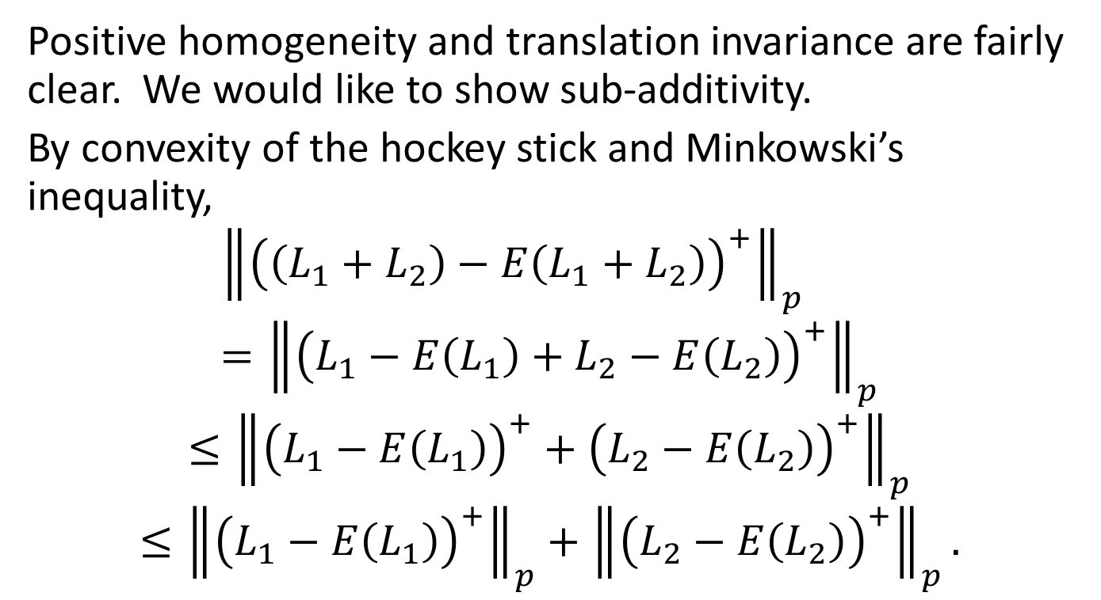
Another Coherent Risk Measure, cont’d
Positive homogeneity and translation invariance are fairly clear. We would like to show sub-additivity.
By convexity of the hockey stick and Minkowski’s inequality,
$${\left\|{\left(\left(L_{1}+L_{2}\right)−E\left(L_{1}+L_{2}\right)\right)}^{+}\right\|}_{p}={\left\|{\left(L_{1}−E\left(L_{1}\right)+L_{2}−E\left(L_{2}\right)\right)}^{+}\right\|}_{p}$$
$$≤{\left\|{\left(L_{1}−E\left(L_{1}\right)\right)}^{+}+{\left(L_{2}−E\left(L_{2}\right)\right)}^{+}\right\|}_{p}$$
$$≤{\left\|{\left(L_{1}−E\left(L_{1}\right)\right)}^{+}\right\|}_{p}+{\left\|{\left(L_{2}−E\left(L_{2}\right)\right)}^{+}\right\|}_{p}.$$

Slide 25
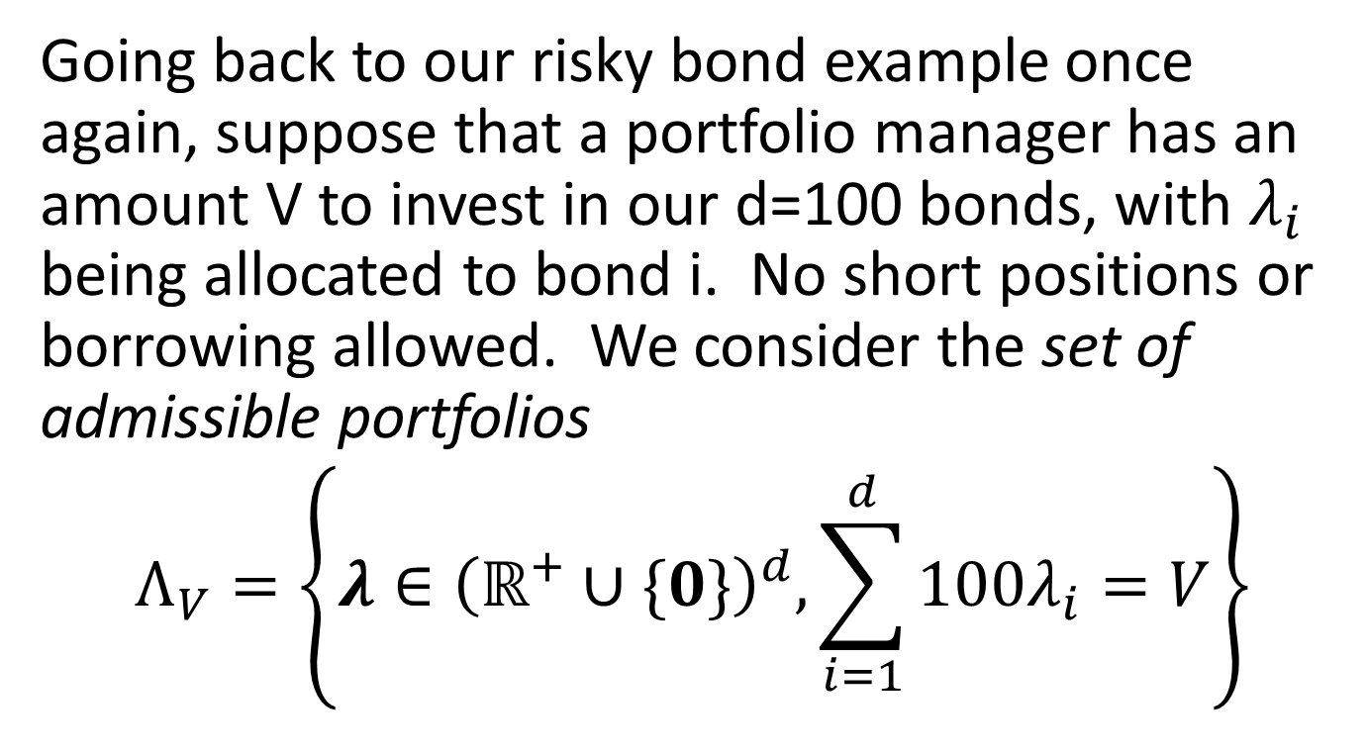
Why VaR Incoherence is Bad
Going back to our risky bond example once again, suppose that a portfolio manager has an amount V to invest in our d=100 bonds, with $λ_{i}$ being allocated to bond i. No short positions or borrowing allowed. We consider the set of admissible portfolios
$$Λ_{V}=\left\{λ∈{\left(ℝ^{+}∪\{0\}\right)}^{d},\sum_{i=1}^{d}{100λ_{i}}=V\right\}$$

Slide 26
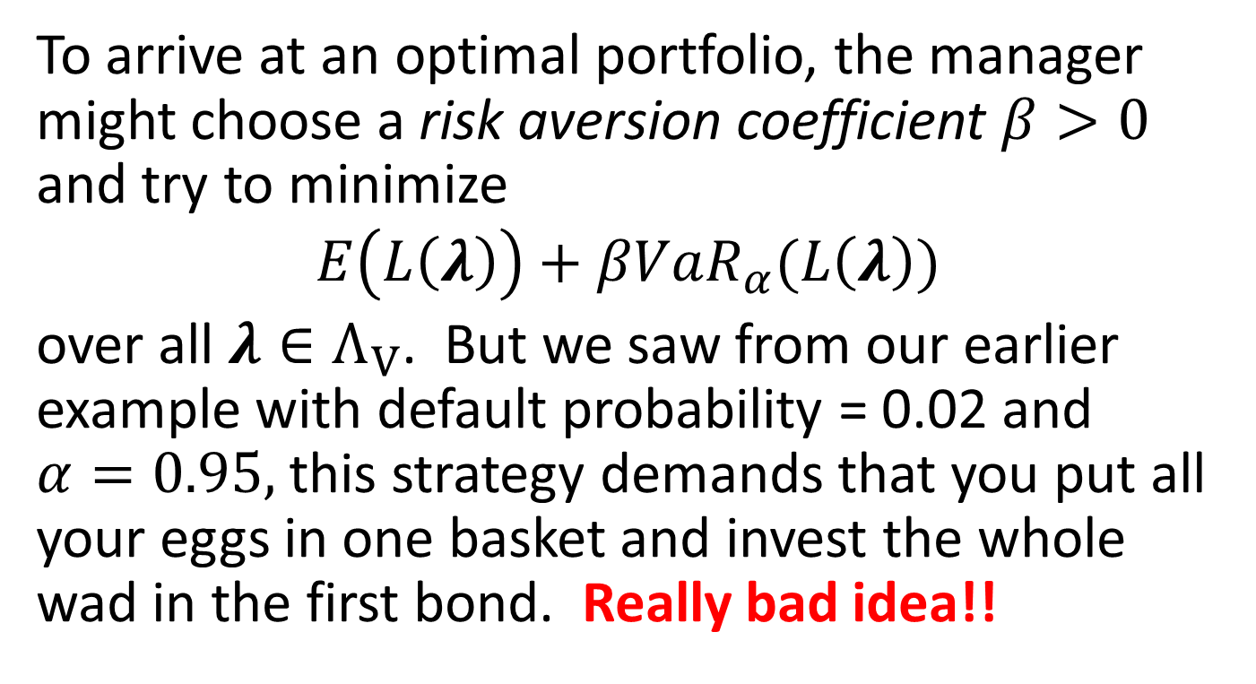
Why VaR Incoherence is Bad, cont’d
To arrive at an optimal portfolio, the manager might choose a risk aversion coefficient $β>0$ and try to minimize
$$E\left(L\left(λ\right)\right)+βVaR_{α}(L\left(λ\right))$$
over all $λ∈Λ_{V}$. But we saw from our earlier example with default probability = 0.02 and $α=0.95,$ this strategy demands that you put all your eggs in one basket and invest the whole wad in the first bond. Really bad idea!!

Slide 27
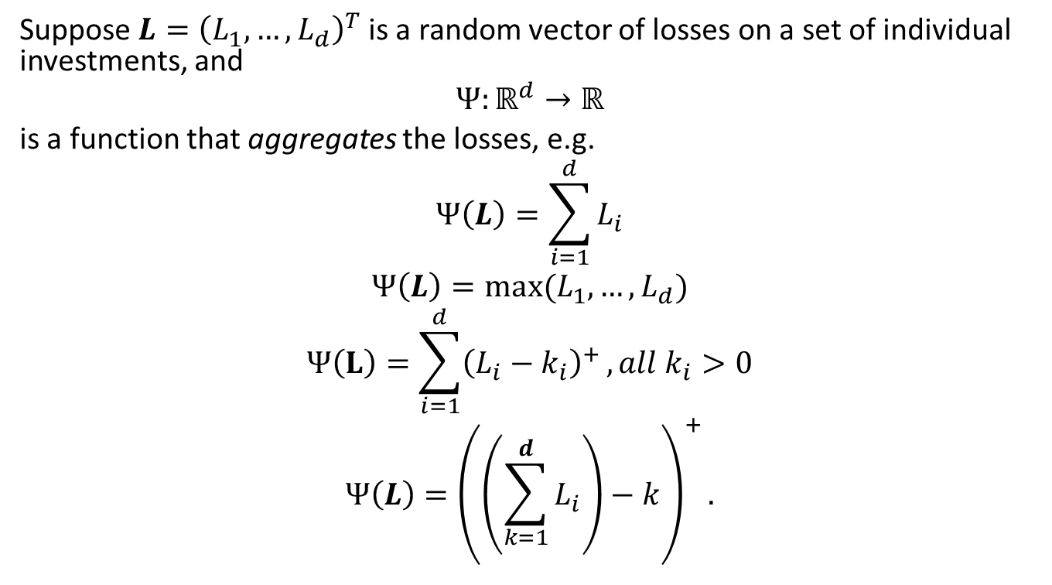
Bounds for Aggregate Risks
Suppose $L={\left(L_{1},…,L_{d}\right)}^{T}$ is a random vector of losses on a set of individual investments, and
$$Ψ:ℝ^{d}→ℝ$$
is a function that aggregates the losses, e.g.
$$Ψ\left(L\right)=\sum_{i=1}^{d}{L_{i}}$$
$$Ψ\left(L\right)=max⁡(L_{1},…,L_{d})$$
$$Ψ\left(L\right)=\sum_{i=1}^{d}{{\left(L_{i}−k_{i}\right)}^{+}}, all k_{i}>0$$
$$Ψ\left(L\right)={\left(\left(\sum_{k=1}^{d}{L_{i}}\right)−k\right)}^{+}.$$

Slide 28
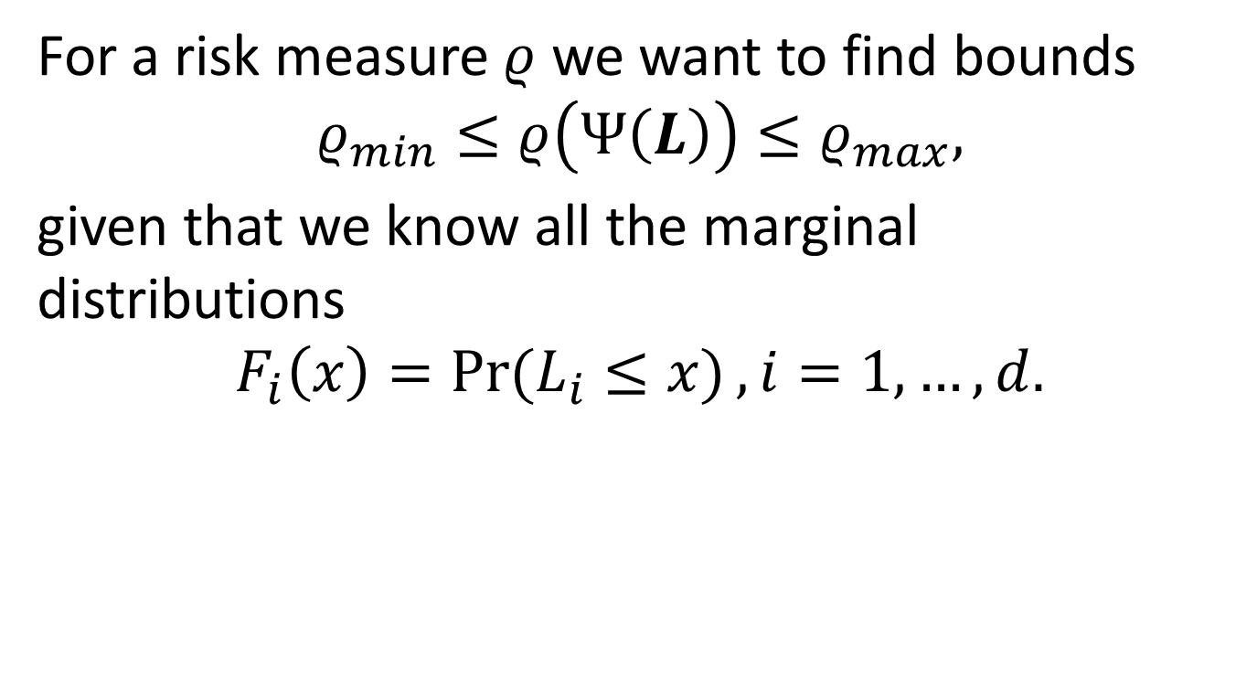
Bounds for Aggregates Risk, cont’d
For a risk measure $ρ$ we want to find bounds
$$ρ_{min}≤ρ\left(Ψ\left(L\right)\right)≤ρ_{max},$$
given that we know all the marginal distributions
$$F_{i}\left(x\right)=\operatorname{Pr}{(L_{i}≤x)}, i=1,…,d.$$

Slide 29
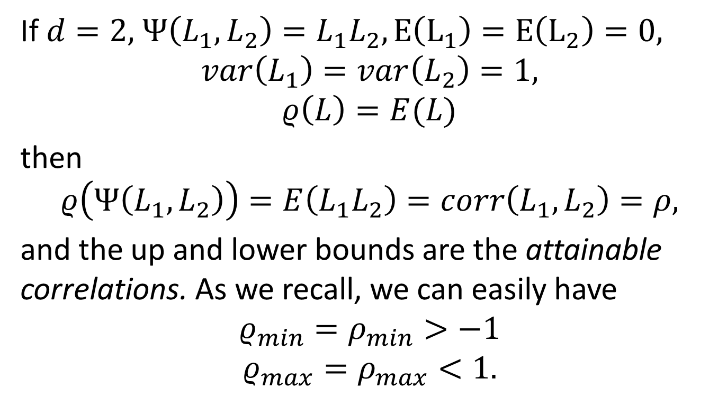
A Simple Example
If $d=2,$ $Ψ\left(L_{1},L_{2}\right)=L_{1}L_{2}, E\left(L_{1}\right)=E\left(L_{2}\right)=0,$
$$var\left(L_{1}\right)=var\left(L_{2}\right)=1,$$
$$ρ\left(L\right)=E(L)$$
then
$$ρ\left(Ψ\left(L_{1},L_{2}\right)\right)=E\left(L_{1}L_{2}\right)=corr\left(L_{1},L_{2}\right)=ρ,$$
and the up and lower bounds are the attainable correlations. As we recall, we can easily have
$$ρ_{min}=ρ_{min}>−1$$
$$ρ_{max}=ρ_{max}<1.$$

Slide 30
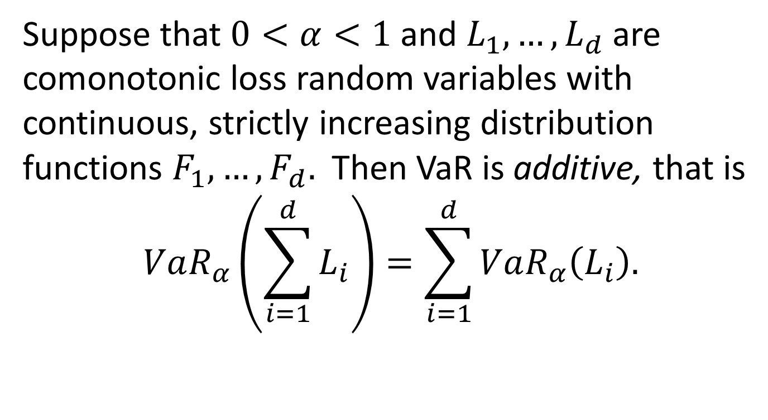
VaR for Comonotonic Loss Random Variables
Suppose that $0<α<1$ and $L_{1},…,L_{d}$ are comonotonic loss random variables with continuous, strictly increasing distribution functions $F_{1},…,F_{d}.$ Then VaR is additive, that is
$$VaR_{α}\left(\sum_{i=1}^{d}{L_{i}}\right)=\sum_{i=1}^{d}{VaR_{α}\left(L_{i}\right).}$$

Slide 31
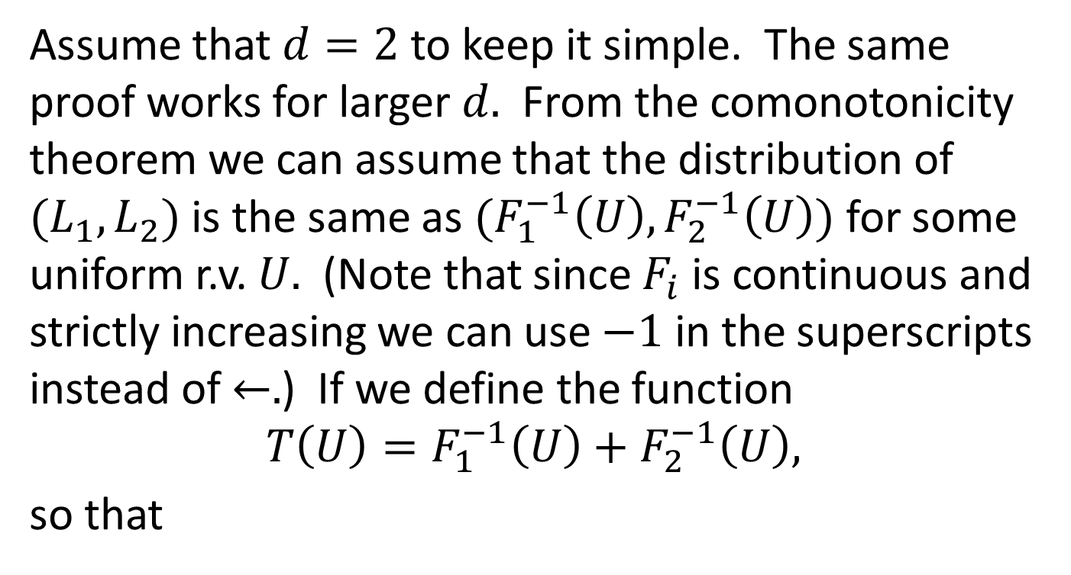
Comonotonic Losses, cont’d
Assume that $d=2$ to keep it simple. The same proof works for larger $d.$ From the comonotonicity theorem we can assume that the distribution of $(L_{1},L_{2})$ is the same as $(F_{1}^{−1}\left(U\right),F_{2}^{−1}\left(U\right))$ for some uniform r.v. $U.$ (Note that since $F_{i}$ is continuous and strictly increasing we can use $−1$ in the superscripts instead of $←.$) If we define the function
$$T\left(U\right)=F_{1}^{−1}\left(U\right)+F_{2}^{−1}\left(U\right),$$
so that

Slide 32
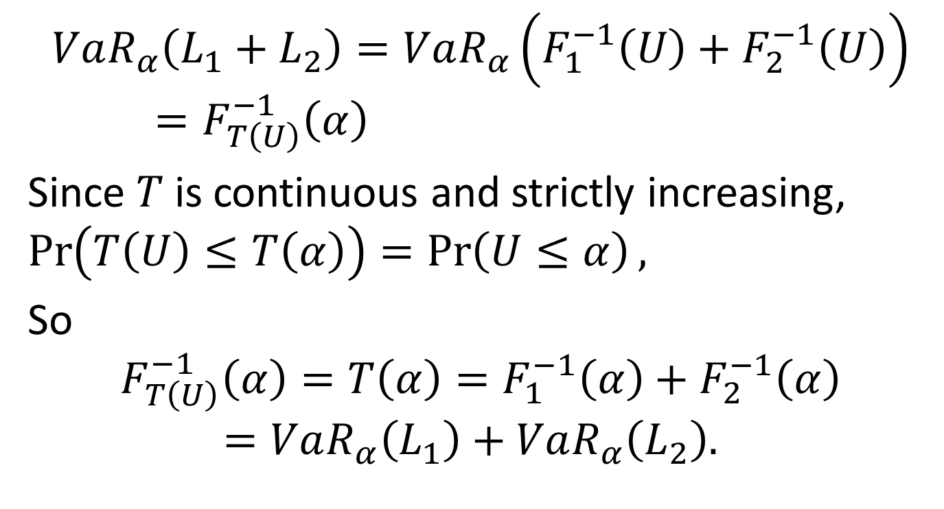
Comonotonic Losses, cont’d
$$VaR_{α}\left(L_{1}+L_{2}\right)=VaR_{α}\left(F_{1}^{−1}\left(U\right)+F_{2}^{−1}\left(U\right)\right)=F_{T\left(U\right)}^{−1}\left(α\right)$$
Since $T$ is continuous and strictly increasing, $\operatorname{Pr}\left(T\left(U\right)≤T\left(α\right)\right)=\operatorname{Pr}\left(U≤α\right),$
So
$$F_{T\left(U\right)}^{−1}\left(α\right)=T\left(α\right)=F_{1}^{−1}\left(α\right)+F_{2}^{−1}\left(α\right)=VaR_{α}\left(L_{1}\right)+VaR_{α}\left(L_{2}\right).$$

Slide 33
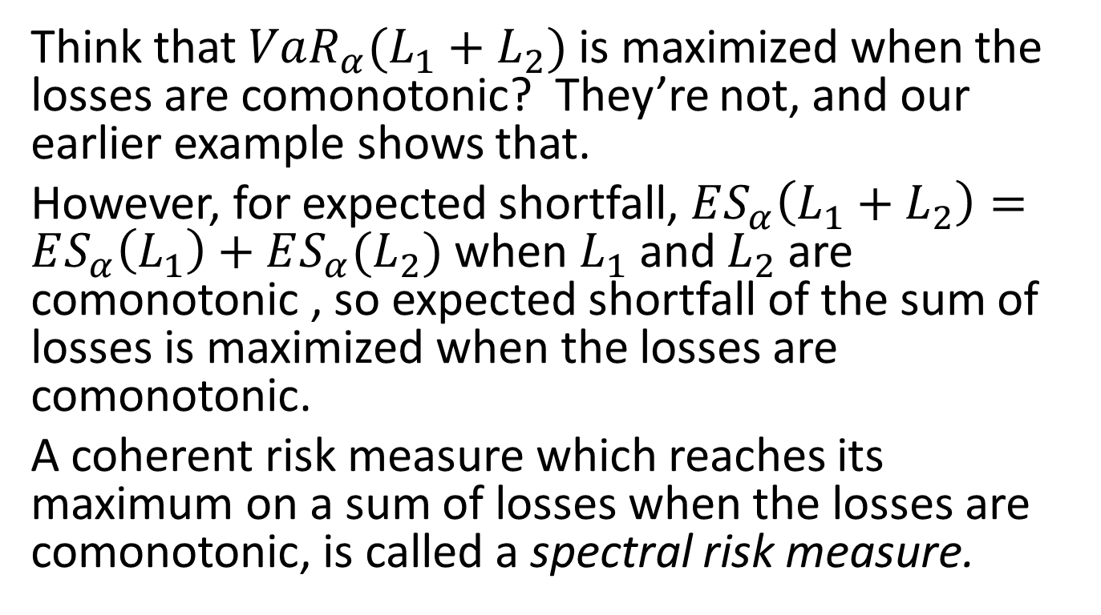
An Interesting Fallacy
Think that $VaR_{α}(L_{1}+L_{2})$ is maximized when the losses are comonotonic? They’re not, and our earlier example shows that.
However, for expected shortfall, $ES_{α}\left(L_{1}+L_{2}\right)=ES_{α}\left(L_{1}\right)+ES_{α}(L_{2})$ when $L_{1}$ and $L_{2}$ are comonotonic , so expected shortfall of the sum of losses is maximized when the losses are comonotonic.
A coherent risk measure which reaches its maximum on a sum of losses when the losses are comonotonic, is called a spectral risk measure.

